Slide 1
Country Census2
File created on: 3/4/23 5:19:37 PM PST

Slide 2


Slide 3
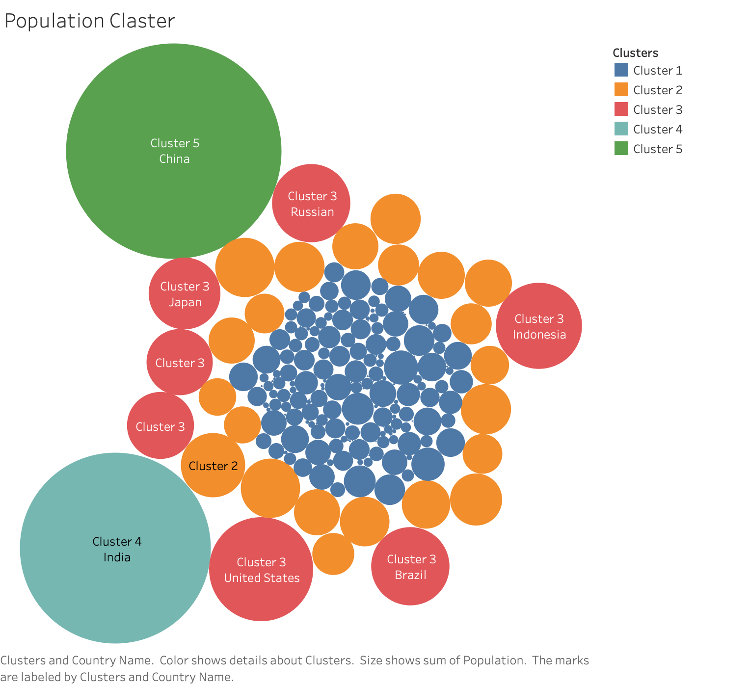

Slide 4
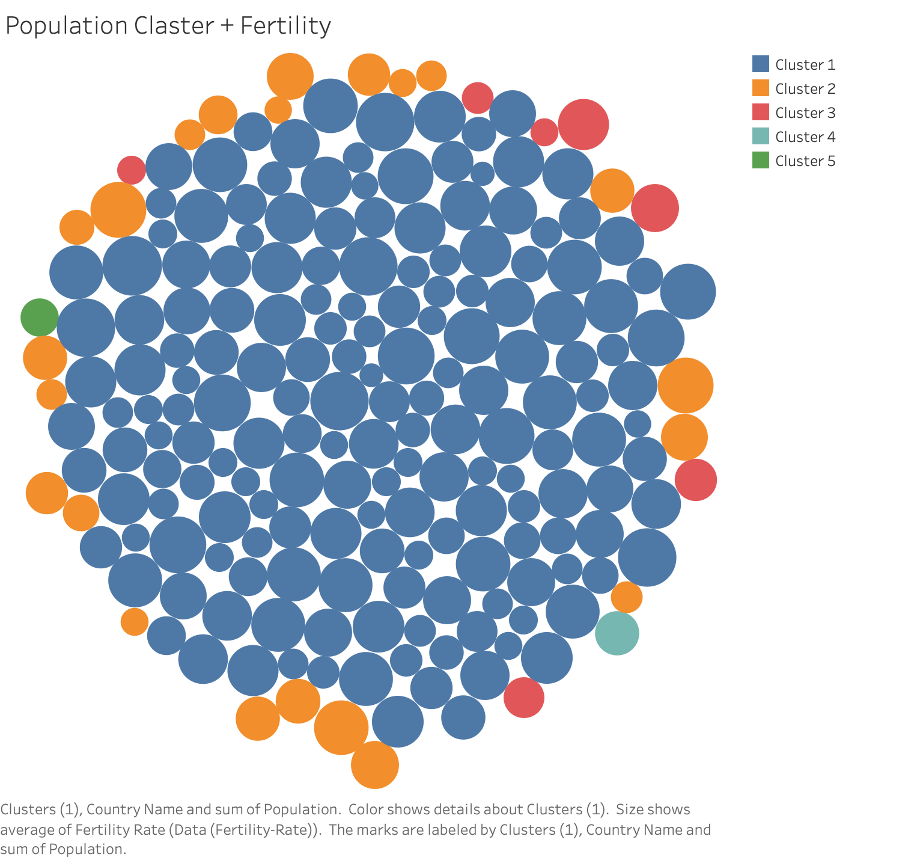

Slide 5
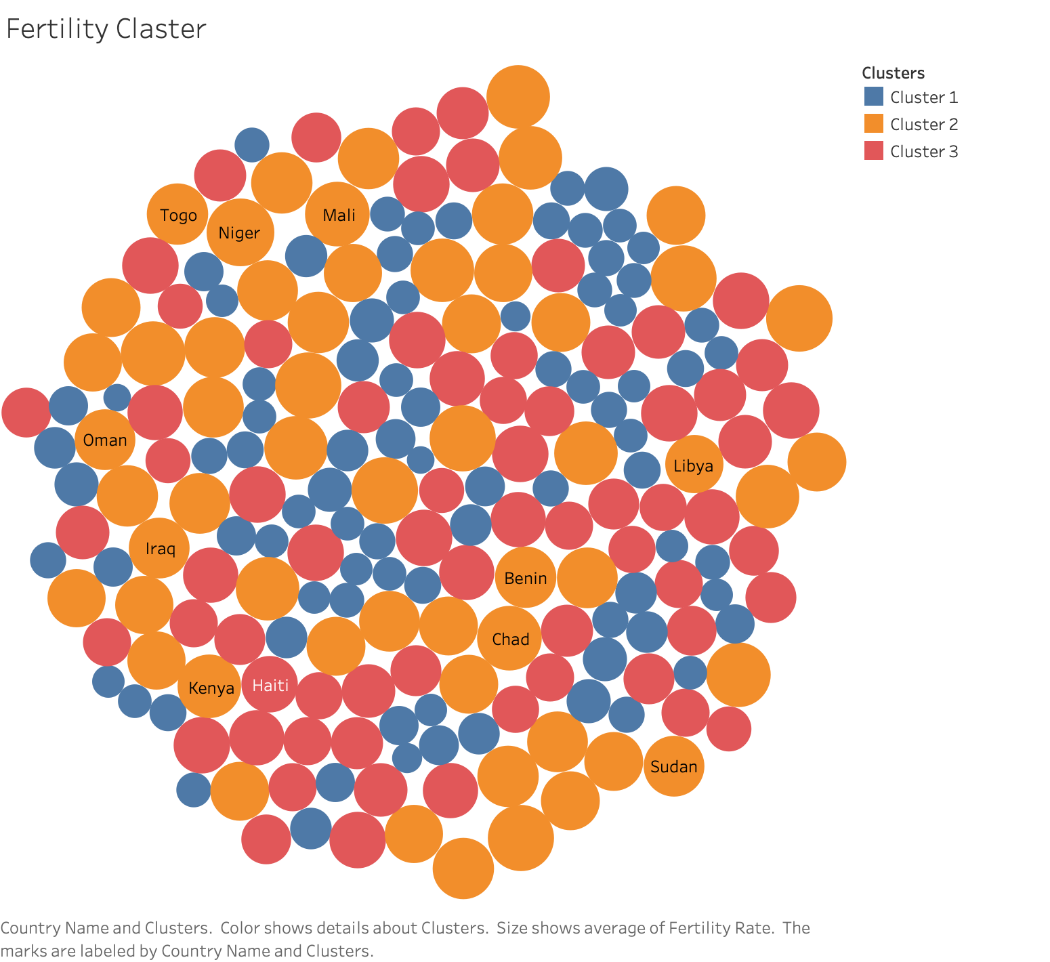

Slide 6
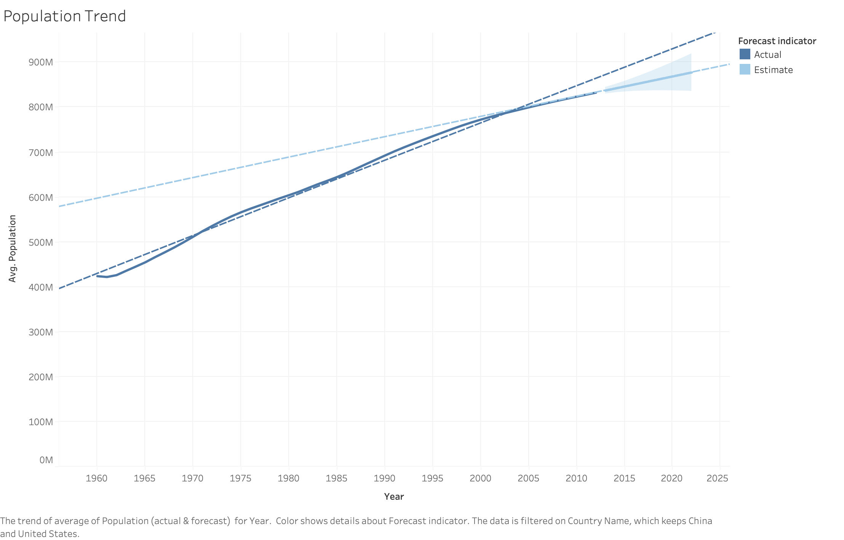

Slide 7


